Slide 1

Computer Architecture

Slide 2
Chapter 7.
Advanced Architecture
Chapter 7.1
Parallel Processor
Multi Processor
Vector Processing
Array Processing
Grid Compouting
Etc.

Slide 3
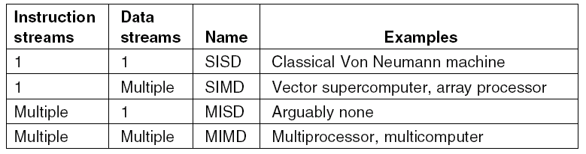
Taxonomy of Parallel Computers (1)
Chapter 7.2
Table 7-1. Flynn’s taxonomy of parallel computers.
.

Slide 4
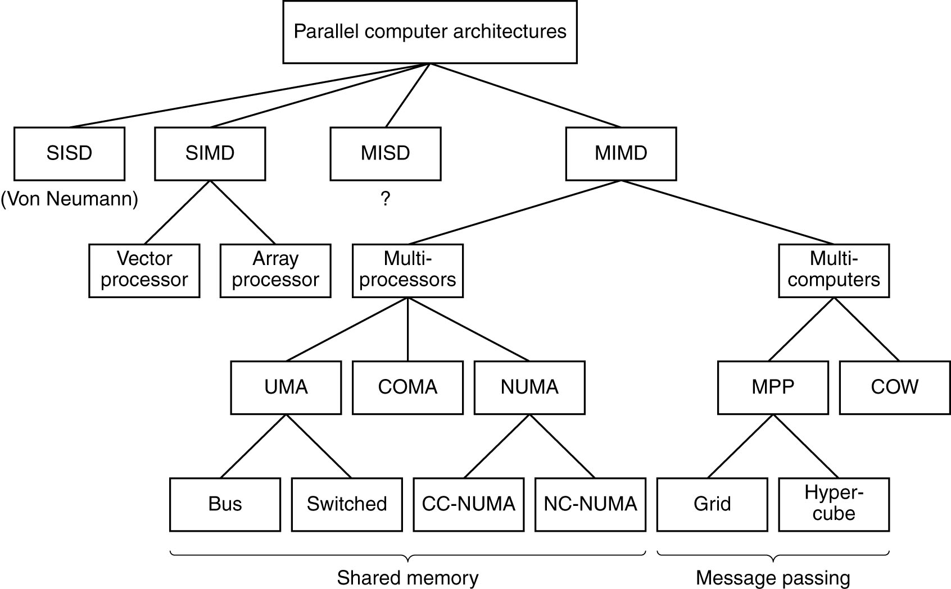
Taxonomy of Parallel Computers (2)
Chapter 7.3
Figure 7-1. A taxonomy of parallel computers.

Slide 5
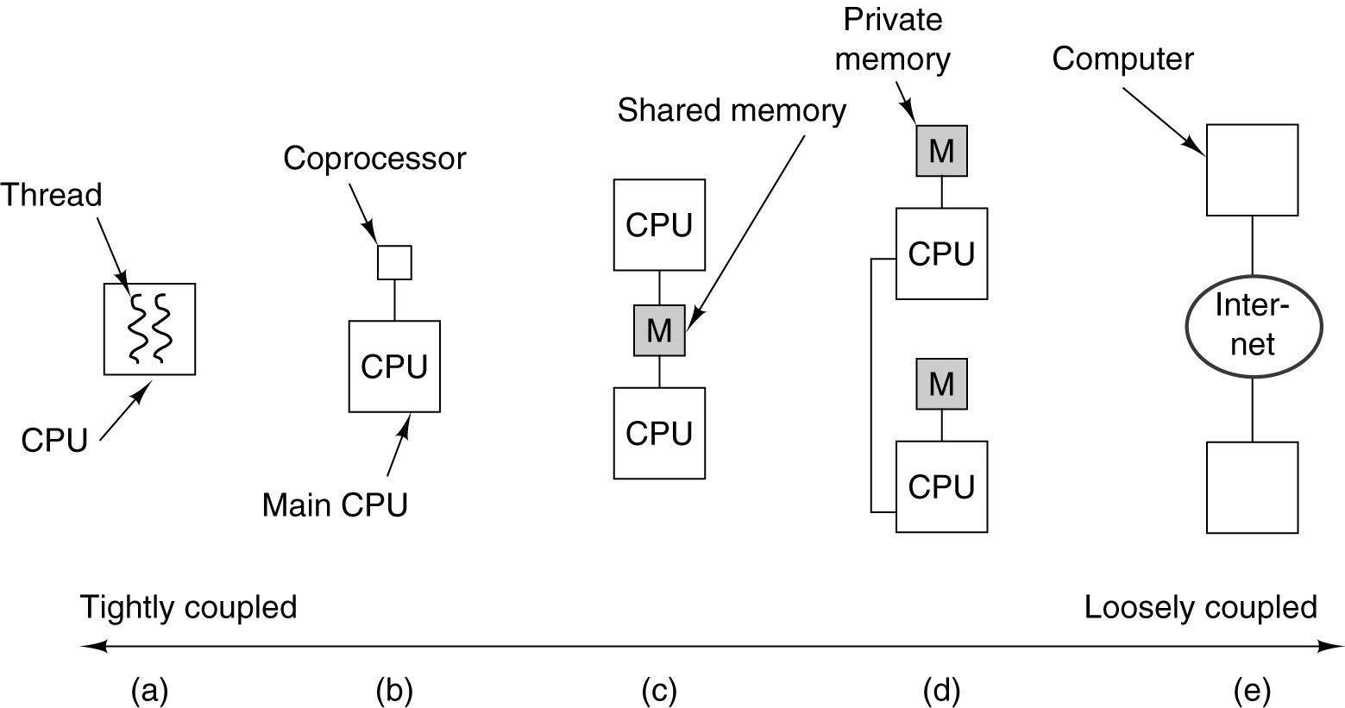
Parallel Computer Architectures
Chapter 7.4
Figure 7-2. (a) On-chip parallelism. (b) A coprocessor.
(c) A multiprocessor. (d) A multicomputer. (e) A grid.

Slide 6
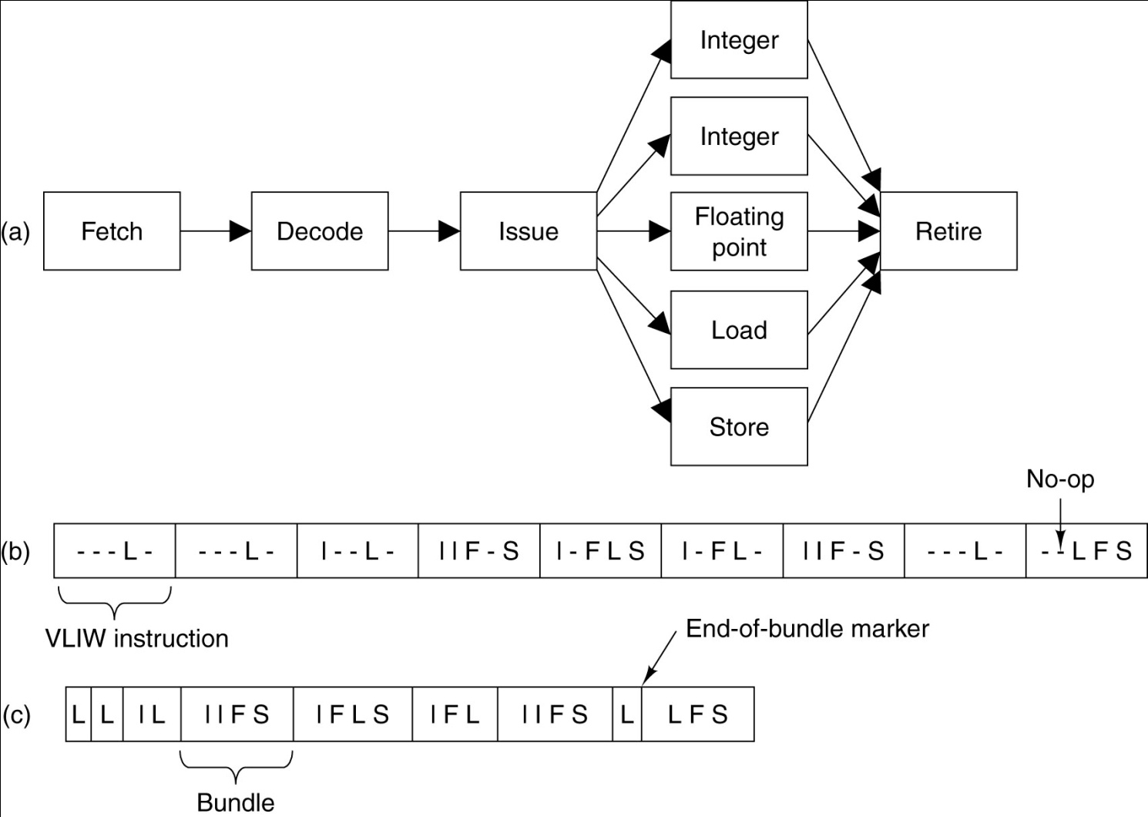
Instruction-Level Parallelism
Chapter 7.5
Figure 7-3. (a) A CPU pipeline. (b) A sequence of VLIW instructions.
(c) An instruction stream with bundles marked.

Slide 7
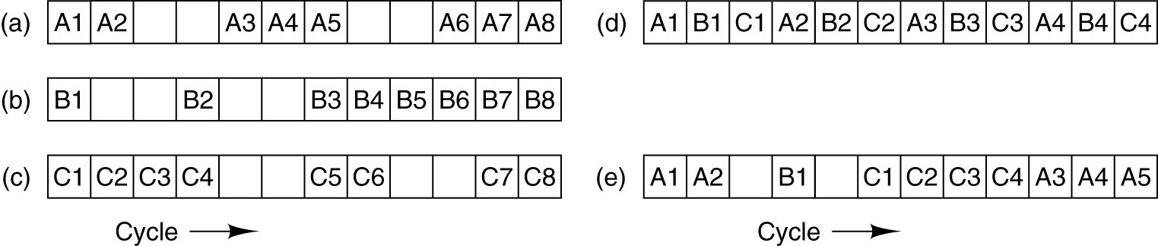
On-Chip Multithreading (1)
Chapter 7.6
Figure 7-4. (a) – (c) Three threads. The empty boxes indicated that the thread
has stalled waiting for memory. (d) Fine-grained multithreading.
(e) Coarse-grained multithreading.

Slide 8
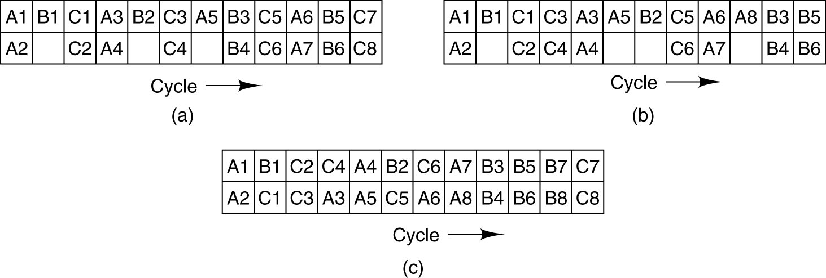
On-Chip Multithreading (2)
Chapter 7.7
Figure 7-5. Multithreading with a dual-issue superscalar CPU.
(a) Fine-grained multithreading.
(b) Coarse-grained multithreading.
(c) Simultaneous multithreading.

Slide 9
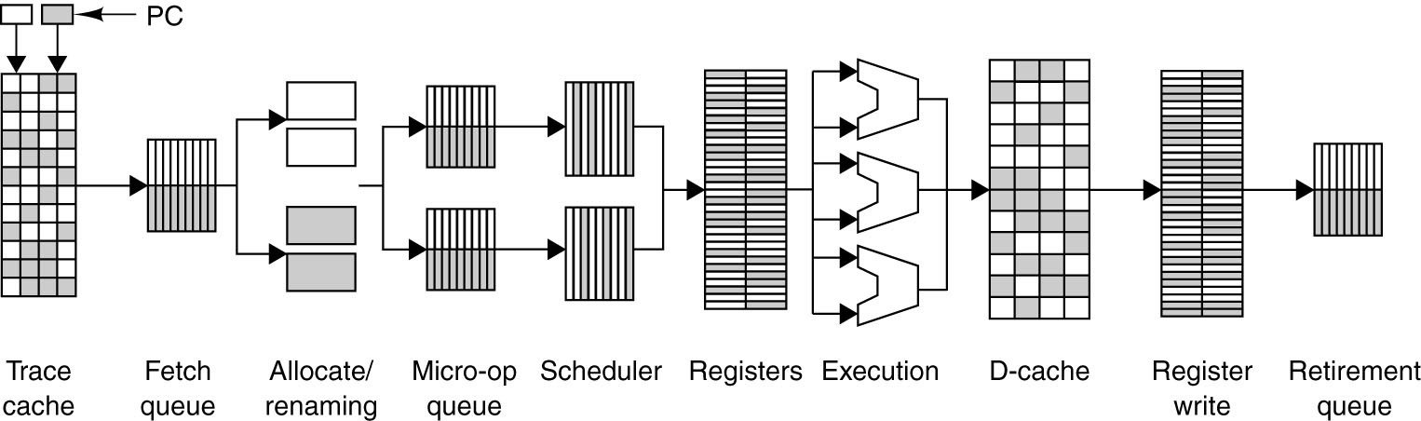
Hyperthreading on the Pentium 4
Chapter 7.8
Figure 7-16 Resource sharing between threads in the
Pentium 4 NetBurst microarchitecture.

Slide 10
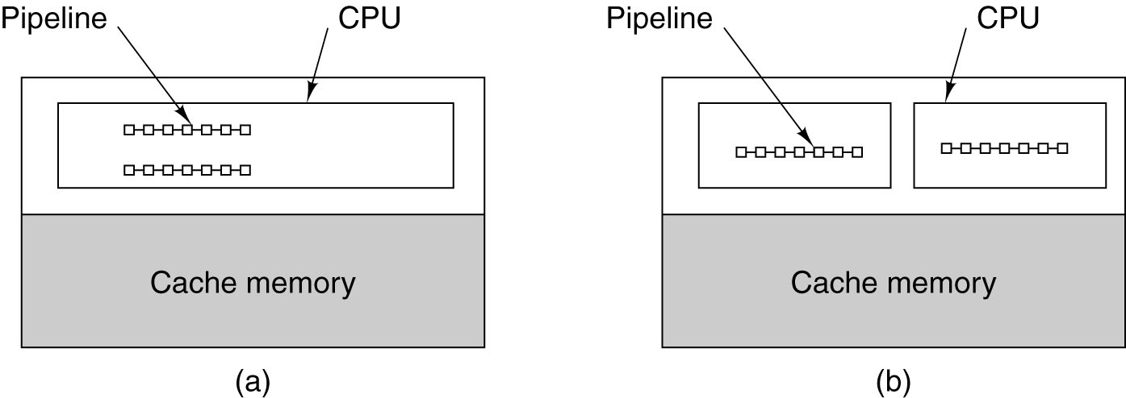
Homogeneous Multiprocessors on a Chip
Chapter 7.9
Figure 7-7. Single-chip multiprocessors.
(a) A dual-pipeline chip. (b) A chip with two cores.

Slide 11
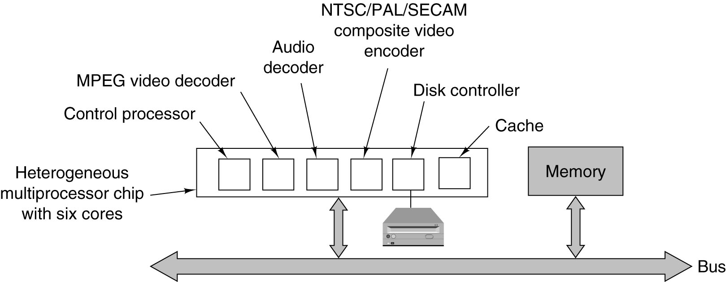
Heterogeneous Multiprocessors on a Chip (1)
Chapter 7.10
Figure 7-8. The logical structure of a simple DVD player contains a heterogeneous
multiprocessor containing multiple cores for different functions.

Slide 12
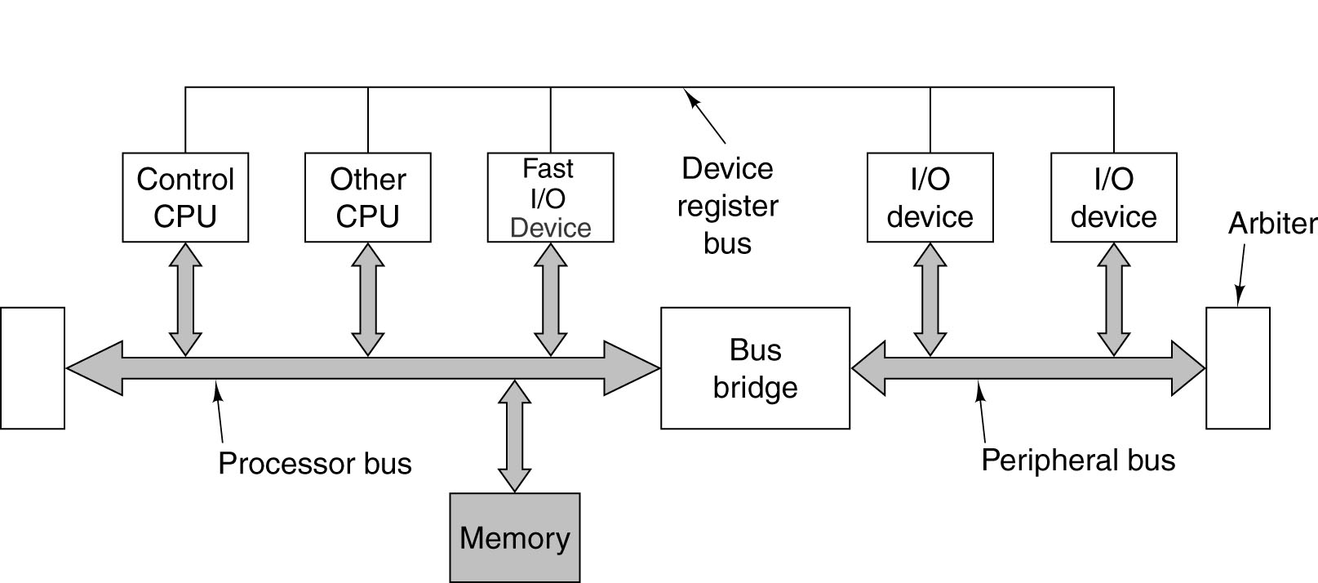
Heterogeneous Multiprocessors on a Chip (2)
Chapter 7.11
Figure 7-9. An example of the IBM CoreConnect architecture.

Slide 13
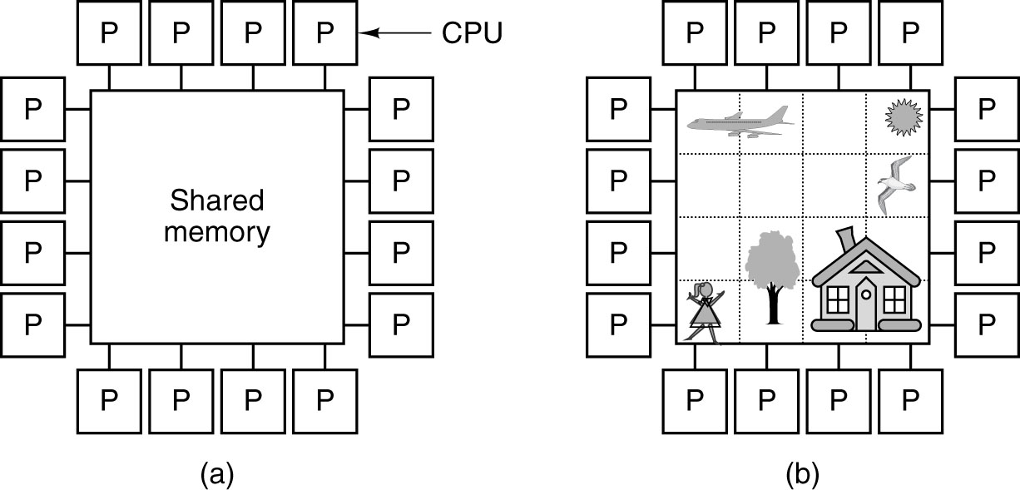
Multiprocessors
Chapter 7.12
Figure 7-10. (a) A multiprocessor with 16 CPUs sharing a common memory.
(b) An image partitioned into 16 sections, each being analyzed by a different CPU.

Slide 14
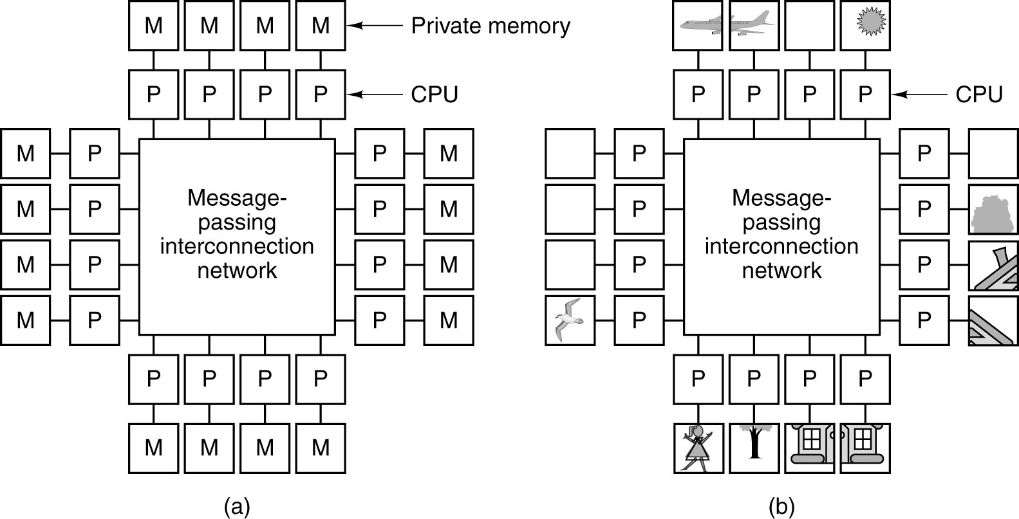
Multicomputers (1)
Chapter 7.13
Figure 7-11. (a) A multicomputer with 16 CPUs, each with its own private memory.
(b) The bit-map image of Fig. 8-17 split up among the 16 memories.

Slide 15
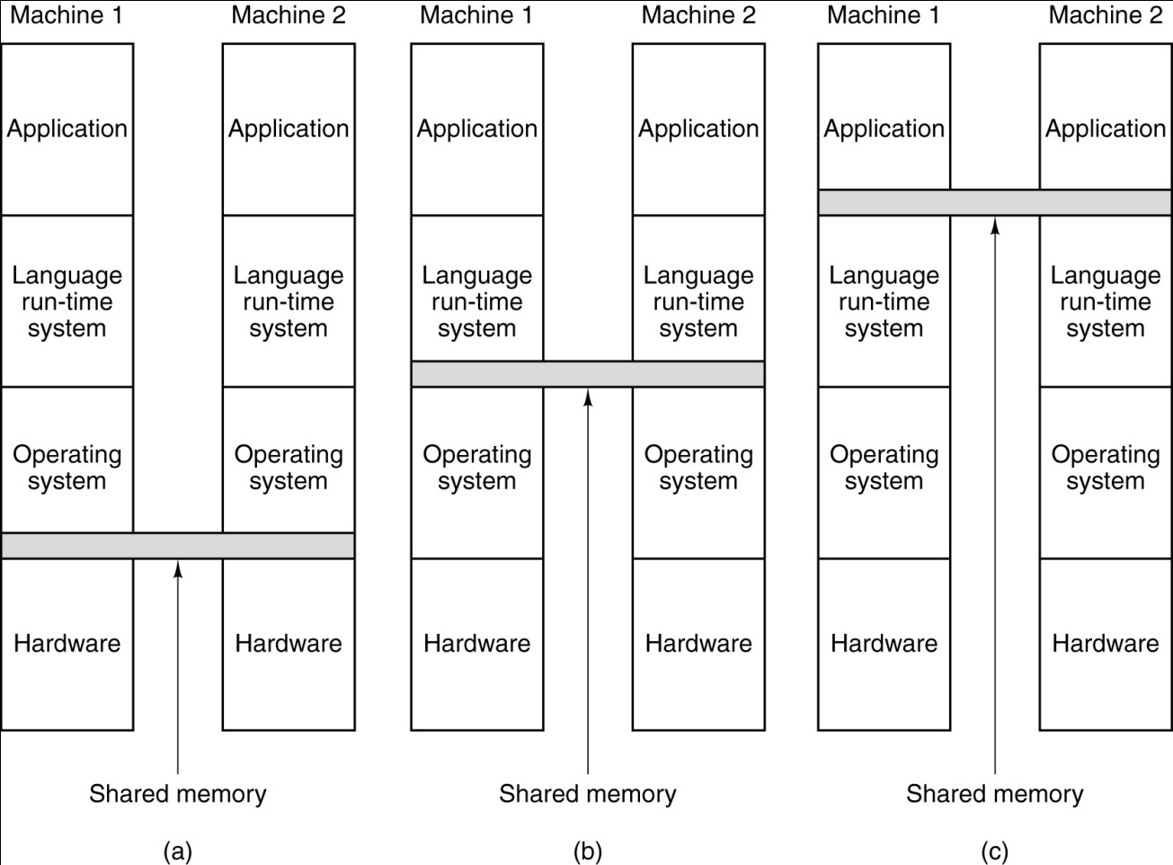
Multicomputers (2)
Chapter 7.14
Figure 7-12. Various layers where shared memory can be implemented.
(a) The hardware. (b) The operating system. (c) The language runtime system.

Slide 16
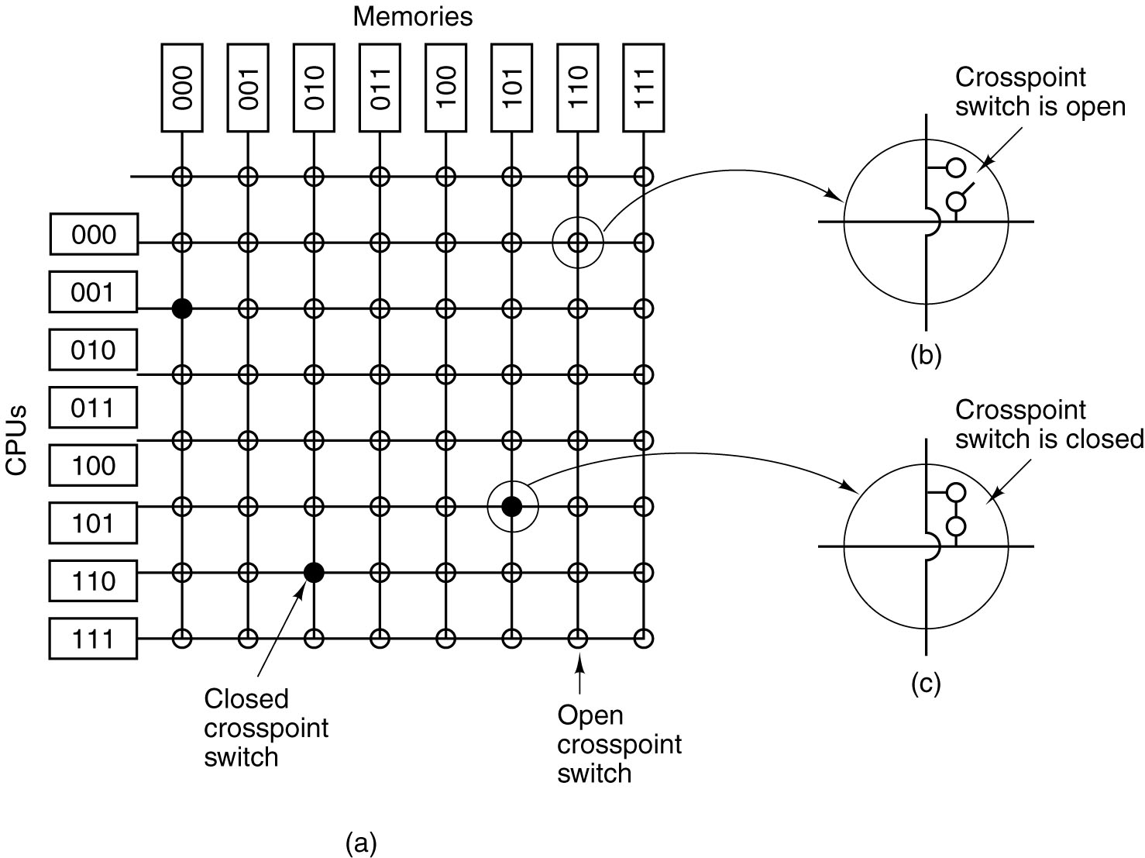
UMA Multiprocessors Using Crossbar Switches
Chapter 7.15
Figure 7-13. (a) An 8 × 8 crossbar switch.
(b) An open crosspoint.
(c) A closed crosspoint.

Slide 17
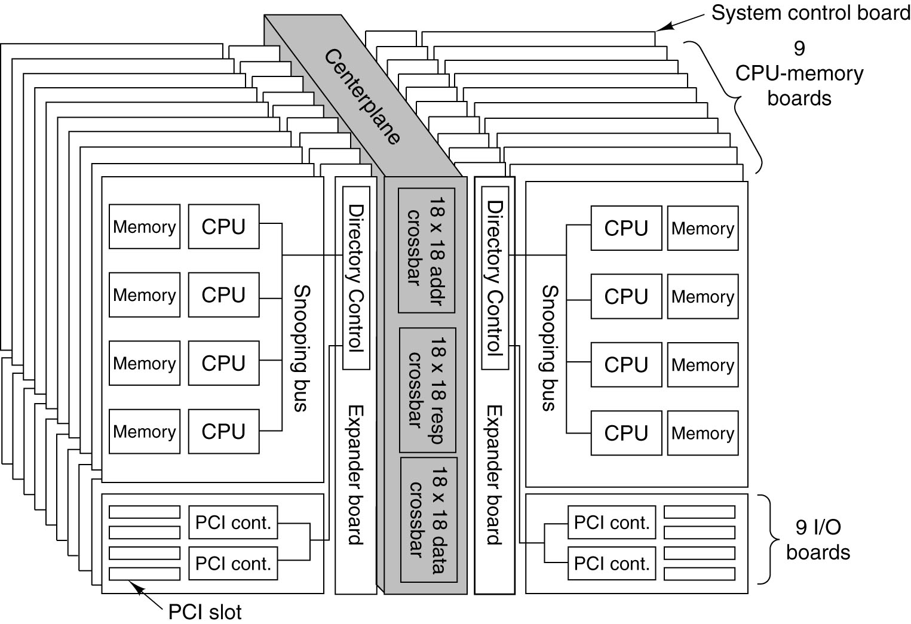
The Sun Fire E25K NUMA Multiprocessor (1)
Chapter 7.16
Figure 7-14. The Sun Microsystems E25K multiprocessor.

Slide 18
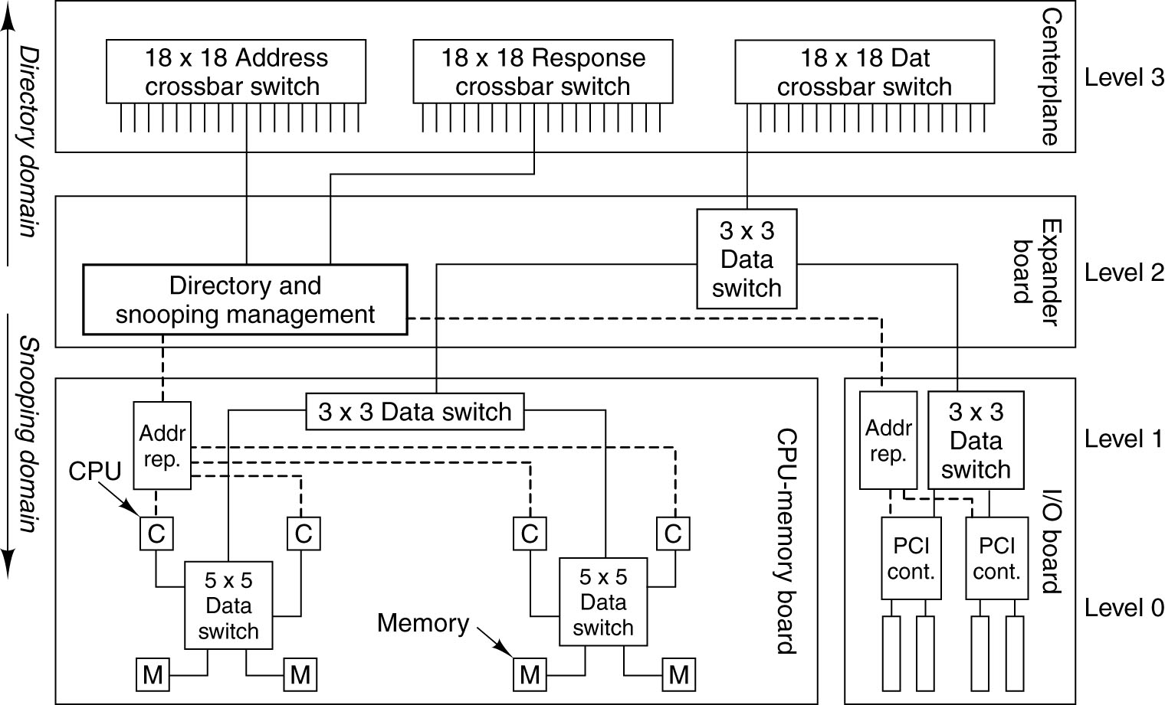
The Sun Fire E25K NUMA Multiprocessor (2)
Chapter 7.17
Figure 7-15. The SunFire E25K uses a four-level interconnect. Dashed lines
are address paths. Solid lines are data paths.

Slide 19
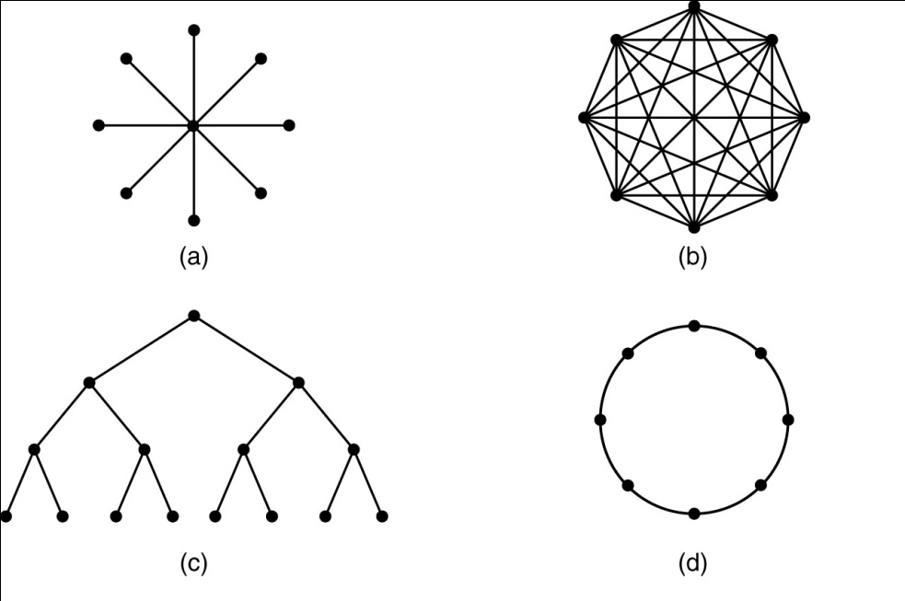

Topology
Chapter 7.18
Figure 7-16. Various topologies. The heavy dots represent switches.
The CPUs and memories are not shown.
(a) A star. (b) A complete interconnect.
(c) A tree. (d) A ring. (e) A grid. (f) A double torus.
(g) A cube. (h) A 4D hypercube.

Slide 20
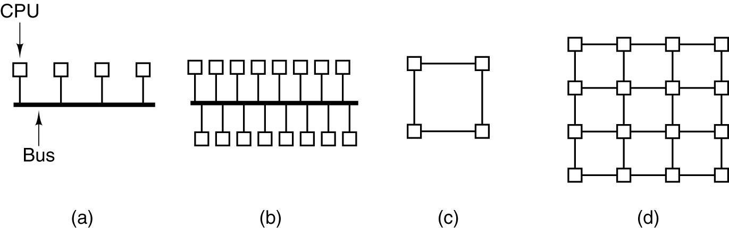
Achieving High Performance
Chapter 7.19
Figure 7-17. (a) A 4-CPU bus-based system. (b) A 16-CPU bus-based system.
(c) A 4-CPU grid-based system. (d) A 16-CPU grid-based system.

Slide 21
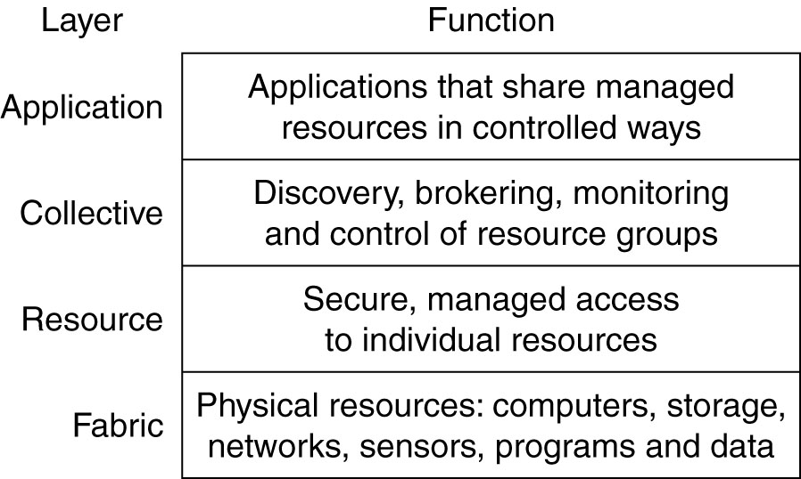
Grid Computing
Chapter 7.20
Figure 7-18. The grid layers.

Slide 22
Vector Processing
The problems formulated in terms of vectors and matrices require
vector processing
Vector Operations – arithmetic operations on large arrays of numbers
- Machine Language Implementation on a conventional machine
- In a vector Computer
C(1:100) = A(1:100) + B(1:100)
Chapter 7.21
ex) DO 20 I = 1,100
20 C(I) = B(I) + (I)
Initialize I = 0
20 Read A(I)
Read B(I)
Store C(I) = A(I) + B(I)
Increment I = I + 1
If I <= 100 go to 20
Continue
Operation Code
Base address Source1
Base address Source2
Base address destination
Vector length
Figure 7-19. Instruction format for vector processor.

Slide 23
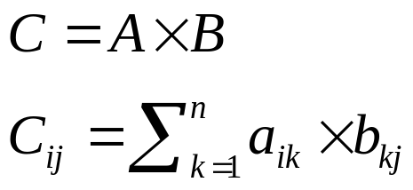
Vector Processing (continued)
- Matrix Multiplication
- Inner Product consists of the sum of k product terms of the form
- Inner Product calculation on a pipeline Vector processor
Chapter 7.22
C = A₁B₁ + A₂B₂ + A₃B₃ + A_{k}B_{k}
C = A₁B₁ + A₅B₅ + A₉B₉ + A₁₃B₁₃ + …
+ A₂B₂ + A₆B6 + A₁₀B₁₀ + A₁₄B₁₄ + …
+ A₃B₃ + A₇B7 + A₁₁B₁₁ + A₁₅B₁₅ + …
+ A₄B₄ + A₈B8 + A₁₂B₁₂ + A₁₆B₁₆ + …
Source
A
Source
B
Multiplier
pipeline
Adder
pipeline
Figure 7-20. Pipeline for calculating an inner product

Slide 24
Vector Processing (continued)
- Memory Interleaving
- Different sets of addresses are assigned to different memory modules
- when the number of modules is a power of 2 the least significant bits
of the address select a memory module
- by staggering the memory access, the effective memory cycle time
can be reduced by a factor close to the number of modules
Supercomputers
- Powerful high-performance machines mostly for scientific computations
- parallel, pipelined processing
- mega flops = million flops, giga flops = billion flops
- Cray-1, Cray-2, Fujitsu VP-200, etc.
Chapter 7.23
Address bus
AR
AR
AR
AR
Memory Array
Memory Array
Memory Array
Memory Array
DR
DR
DR
DR
Data bus
Figure 7-21. Multiple module memory organization

Slide 25
Array Processing
- Attached array processor
- attached to a general purpose computer as a back end machine
- high performance by means of parallel processing with multiple
functional units
- pipelined arithmetic unit
Chapter 7.24
General-purpose
computer
Input-output
interface
Attached array
processor
Main memory
High-speed memory-to-
Local memory
Memory bus
Figure 7-22. Attached array Processor with host computer

